Slide 1
Workbook Process Letters and Analysis of Offers
Internal Use Only
April 2017
EXCEL FILE:
Template for an Analysis of Offers

Slide 2
Disclaimer
The content of this workbook has been produced by KPMG Germany/Deal Advisory on the basis of German accounting standards and/or IFRS, as well as considering KPMG Germany’s firm and country requirements, regulations, processes, policies and best practices. Please check your local accounting and other requirements before applying the content.

Slide 3
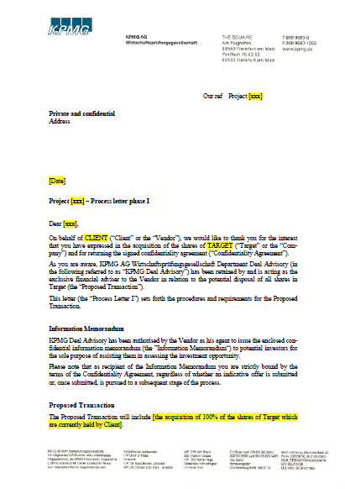
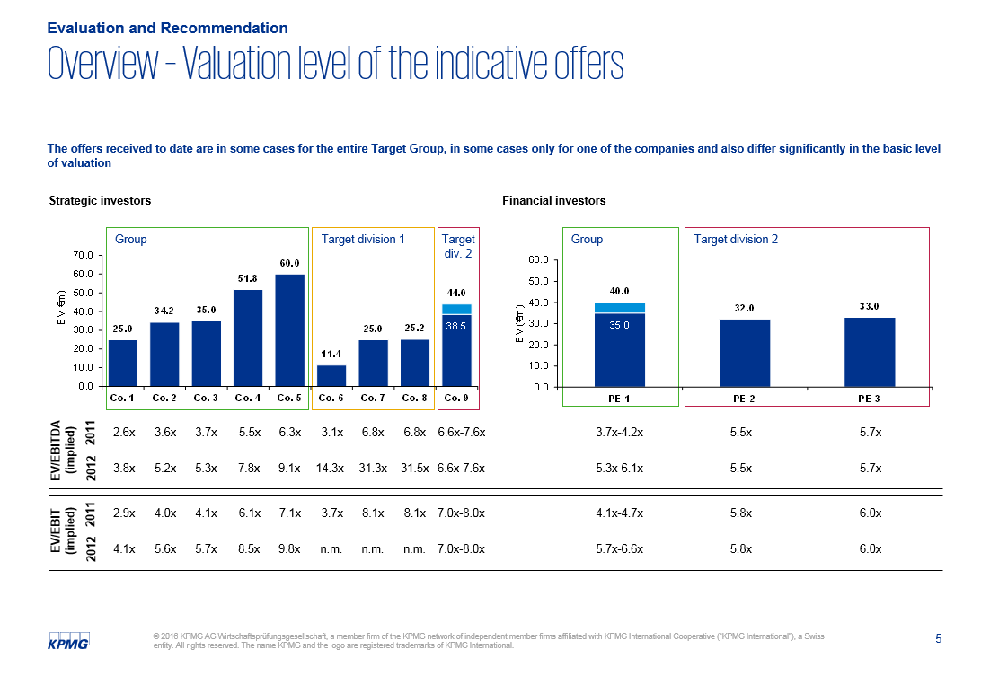
Overview (1/3) – Mission statement
Process Letter and Analysis of Offers
Mission Statement:
Produce a comparability of purchase price offers based on the criteria queried in the Process Letter
Customer situation
Definition/Methodology/Tools of the basis analysis
Sell Side
Adjustment of the schedule of the M&A process subsequently to the initial market approach
Determination of the content of the requested offers by potential bidders for the sake of comparability
Analysis and evaluation of the received offers
Basis for decision-making of the selection of potential investors for the next process phase
Typically with the sale of the entire company/business area of a company as well as the sale of minority holdings
First page of standard Process Letter I
Definition
Process Letter I and II: documents which are send out in the course of an M&A sell side process setting forth next steps, key deadlines, requested documents and bid requirements to potential bidders
Analysis of Offers: document directed at the shareholders of the target company (KPMG’s client) disaggregating any received bids and bringing them on a comparable basis
Methodology
Content of the Process Letters (and in particular the bid requirements) to be agreed upon with client
After receiving any offers: evaluating the offers submitted by the interested parties on the basis of established criteria such as:
Purchase price (enterprise value vs. equity value)
Due diligence requirements
Financing requirements
Corporate strategy, etc.
Tools
Templates for:
Process Letter(s)
Analysis of Offers
Sample slide of Analysis of Bids: Bid comparison
Degree of standardization
Potential for standardization is limited to templates which have to be adapted to the specific case

Slide 4
Overview (2/3) – Pitfalls
Process Letter and Analysis of Offers
No. | Pitfalls/Lessons learned
 | Despite the fact that some of the items in the Process Letter may seem obvious, it is highly recommended to put everything that appears relevant to the process into writing in order to avoid misunderstandings and legal claims for KPMG and the client.
 | Amongst others, small and medium-sized companies avoid making specific statements about the purchase price in the initial process phase as long as they have not received access to the data room or a management presentation. If these parties are forced to submit a bid, they typically issue a very vaguely formulated offer which is extremely difficult to compare with any other bids. In addition, SMEs usually have problems meeting the deadlines set forth in the Process Letter. These parties are generally very inexperienced with regard to M&A issues and should be encouraged to engage an M&A advisor.
 | An “EV to equity“ conversion can only occur if the information provided contains a balance that allows for the derivation of the deductible items.
 | The assumptions and conditions upon which an indicative offer is based may be very extensive. It is recommended to concentrate on the points that deviate from the standard formulations.
1
2
3
4

Slide 5
Overview (3/4) – Core issues (Process Letter)
Process Letter and Analysis of Offers
Core Issue | Specific analysis | Page(s)
How can be ensured that only “real” potential buyers are entering the process instead of parties that are merely interested in collecting confidential information about competitors? How can it be ensured that the management of the interested parties remains feasible? | This is one of the key reasons for Process Letter I since the request for a well established indicative bid provides a (costly) obstacle to any potential bidder. Only those parties which provide a timely and complete indicative offer are given access to the data room, the management expert sessions and Q&A. | 9
2. How can be ensured that the important deadlines are met? | Provide clear and unmistakable information about the respective (bid) deadlines Formulate the consequences of not adhering to the deadlines in order to avoid any legal claims by the interested party | 9
How can be ensured that the offers are comparable? | Formulate a detailed description of the information that should be contained in an indicative offer The less flexibility potential bidders have in structuring their bid, the easier it is to compare the individual offers, e.g.: Price on a cash and debt free basis Payment in a single cash transaction Bank statement only as accepted proof of financing Etc. | 12

Slide 6
Overview (4/4) – Core issues (Analysis of Offers)
Process Letter and Analysis of Offers
Core Issue | Specific analysis | Page(s)
How can offers be compared regarding the purchase price? | Presentation of the enterprise value Conversion to equity value | 18-19
2. Is the offer sufficiently funded? | Description of equity and debt financing: Equity: Presentation of the liquid funds (request current balance on effective date) Debt: Is there a commitment for financing by the banks (e.g. Commitment letter)? | 21
On what assumptions and conditions is the indicative offer based? | List of the relevant items in the summary, especially with differences as far as several offers exist | 20-21
What are the reasons for the potential interested party’s interest? | Description of the interested party’s strategy
Which committees have to approve the transaction? | List of the committees’ concerns Involvement of the committees in the sales process to date
What timeline does the interested party expect until signing/closing? | Indicative timeline and the related achievability How much activity has been demonstrated thus far/ has the timeline been maintained up to now?
What are material open points of the due diligence phase? | Estimation of the scope of the (still outstanding) due diligence allows for conclusions to be drawn about the reliability of the offer
Buyer’s intentions with regard to management and employees | Estimation of the potential buyer’s intentions regarding the future position of the managements after the transaction as well as about personnel measures | 21

Slide 7
Example for Process Letter I & II

Slide 8
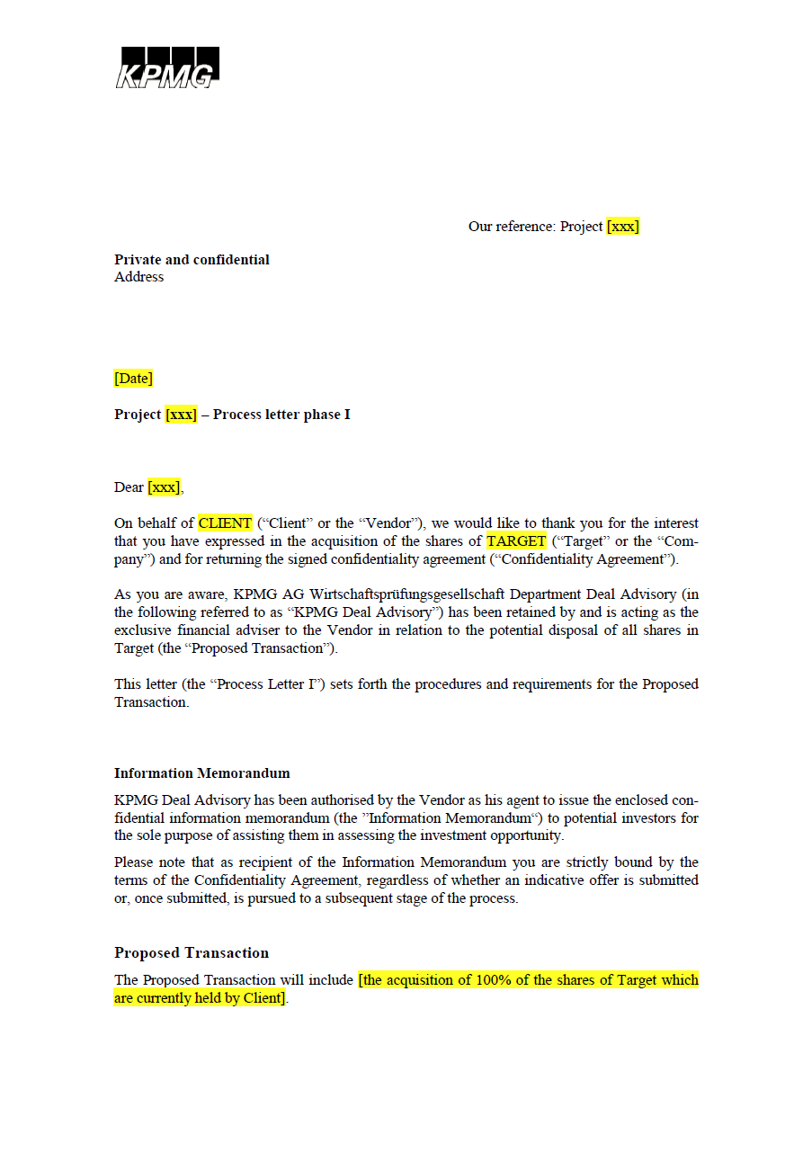
Process Letter I (1/5)
WORD FILE:
Standard process Letter 1
Process Letter and Analysis of Offers
A detailed Process Letter is the basis for a smooth due diligence, effective offer analysis and an efficient and legally protected sales process.
Key content
This letter will only be issued after a Confidentiality Agreement has been signed by the potential bidder
Typically, an Information Memorandum about the target company is prepared and send out
An Information Memorandum is both a descriptive document about the target company, containing information about products, markets, suppliers, customers, historical and forward looking financials, etc. and a marketing tool at the same time
The desired percentage of shares to be divested or retained needs to be defined by the client
1
2
3
1
2
3
Tools
Standard Process Letter I

Slide 9
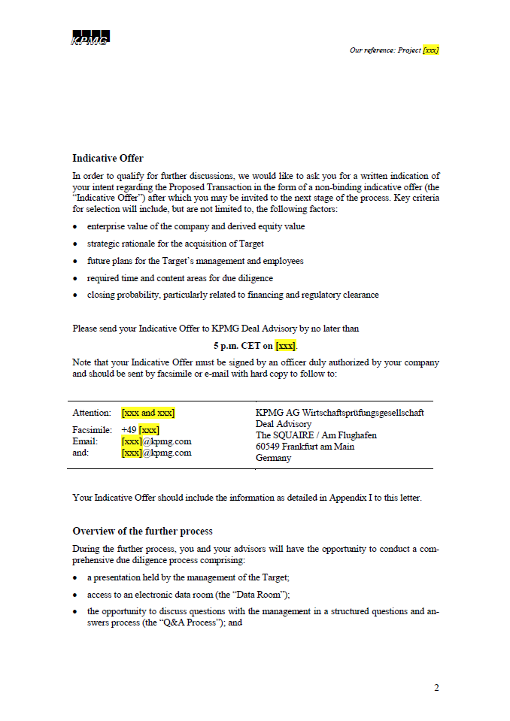
Process Letter I (2/5)
Process Letter and Analysis of Offers
Clearly defined bid requirements makes the Analysis of Offers easier for the advisor.
Key content
The content and level of detail of the indicative offers requested from the potential buyers is decisive for the comparability and the subsequent analysis of the bids
A more detailed description is provided in Appendix I of the Standard Process Letter I
An unmistakable deadline and clear communication channels ensure that all bids are coming in timely and can be further processed by KPMG
In case of a public tendering procedure this is particularly important since advisors typically will be asked to lay out the criteria by which parties have been excluded from the sale process and a delayed bid might be a reason for an exclusion from the process
The description of the immediate next steps is important in order to drive the M&A process
It is very important that potential buyers are not being granted access to the data room before they have submitted a complete, timely and well established indicative offer which signals a true intention to acquire the company (instead of merely collecting confidential information)
4
5
4
5
6
6
Tools
Standard Process Letter I

Slide 10
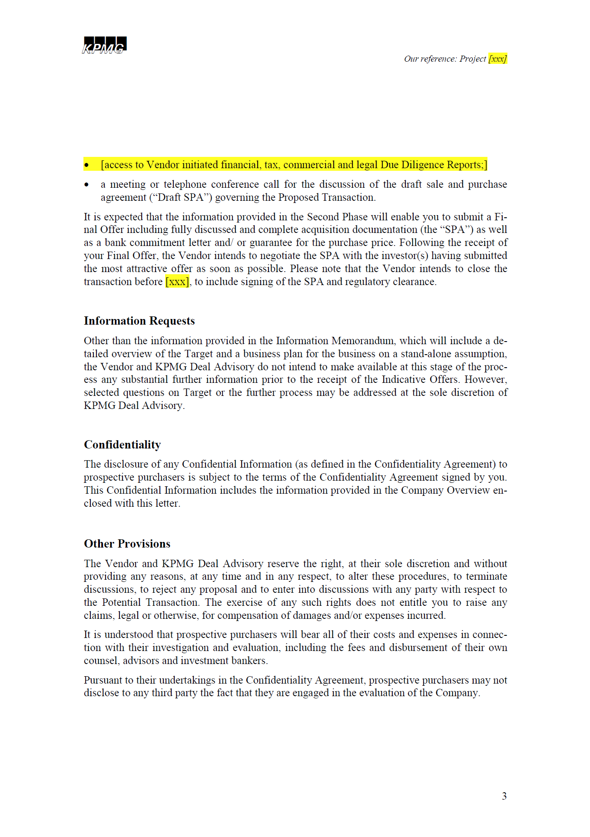
Process Letter I (3/5)
Process Letter and Analysis of Offers
The question of the provider of the first draft of the SPA and the note regarding the termination of the process to the sole discretion of the buyer and the advisor are of crucial importance in the Process Letter.
Key content
The information provided and the respective steps may vary depending on the size of the asset, the field of potential buyers and the related sector knowledge of the players
The question of which party will provide a first draft of the SPA is absolutely crucial since the initial SPA sets the anchor for the SPA negotiation. In most cases, the draft SPA will be provided by the seller, but there are certain regions where potential buyer present the initial document
This clause is particularly important since disgruntled bidders who were excluded in the very last phase of the transaction and have spend significant amounts of time and money for the due diligence (e.g. external advisors, internal M&A and due diligence staff, etc.) often seek to recover their costs by suing the sell side advisor. This is relatively common during:
Divestment processes resulting from insolvencies and insolvency administrators as KPMG’s clients
Public tendering processes with public authorities as KPMG’s clients
6
7
6
7
8
8
Tools
Standard Process Letter I

Slide 11
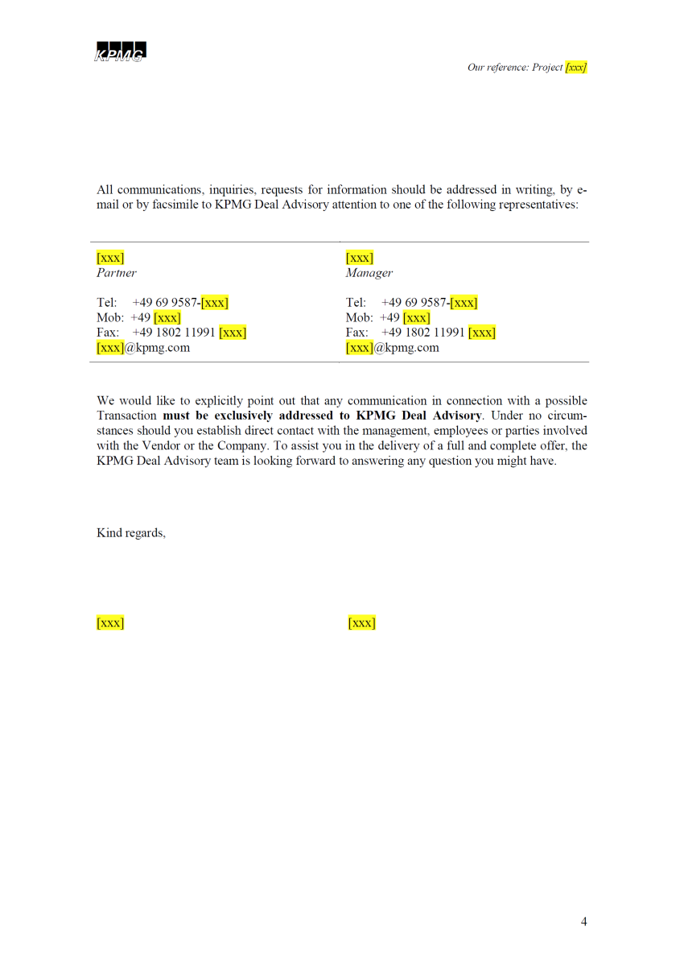
Process Letter I (4/5)
Process Letter and Analysis of Offers
Controlling the flow of information is a crucial task for the sell side advisor since it minimizes the risk for the client.
Key content
It is extremely important that all document and file exchanges, meeting requests, questions by the bidders, answers by the client and any other information flow between buyer and seller go through the hands of KPMG:
It is one of the sell side advisor’s responsibilities to document the information exchange in a way that all information that the buyer received (and possibly used in the calculation of the purchase price), can be monitored
Otherwise, the final buyer could claim that he did not have knowledge of certain issues (e.g. environmental issues with the site) and hold the seller or KPMG liable
9
9
Tools
Standard Process Letter I

Slide 12
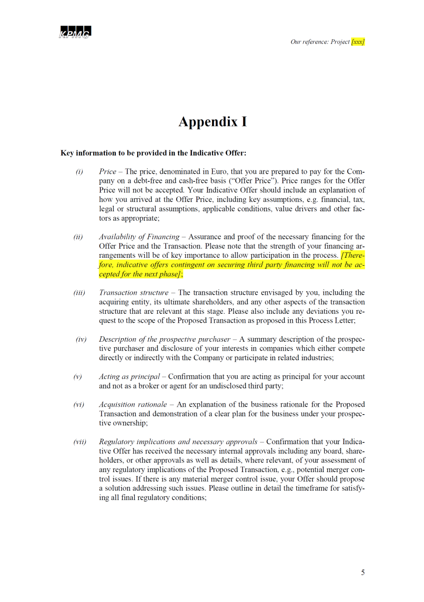
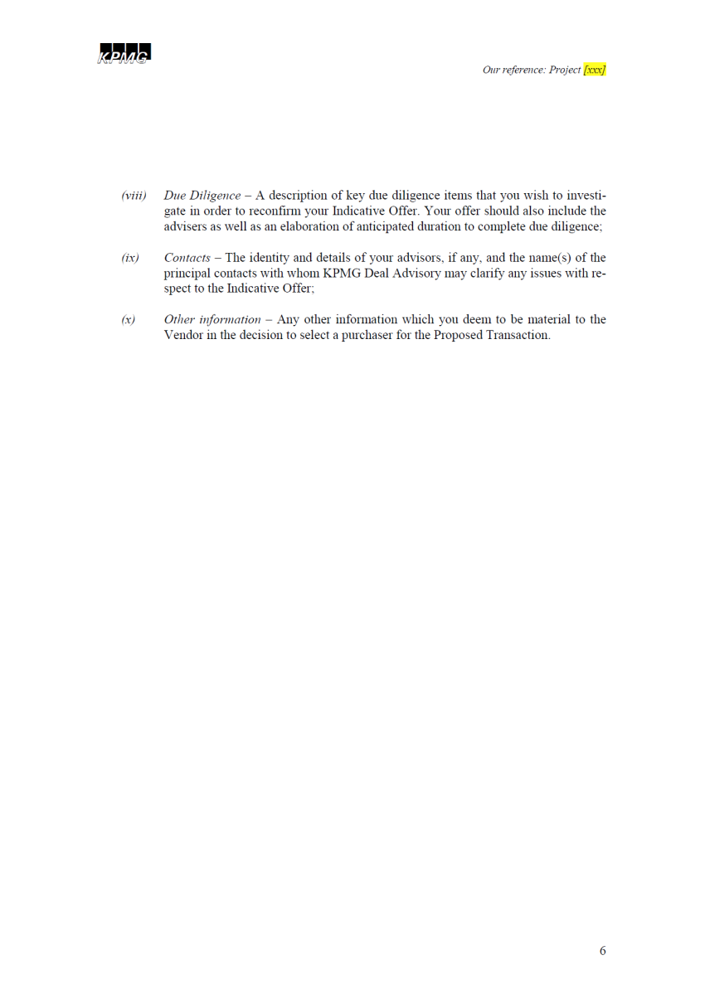
Process Letter I (5/5)
Process Letter and Analysis of Offers
A very detailed description of what is expected in terms of a written bid from an interested party saves time and resources and leads to a better result for KPMGs clients.
Tools
Standard Process Letter I

Slide 13
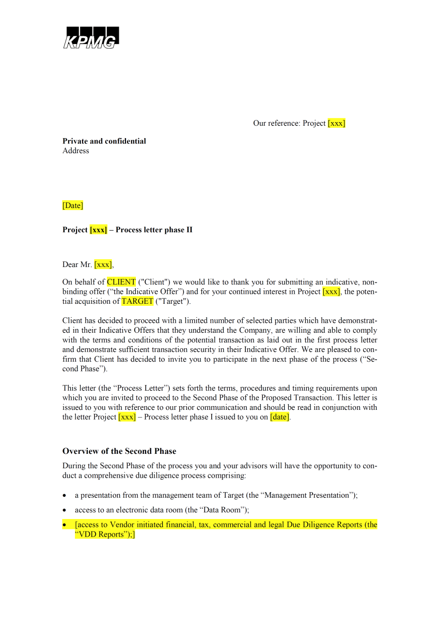
Process Letter II
Process Letter and Analysis of Offers
In the vast majority of M&A processes there are two bidding rounds and hence 2 Process Letters.
The second Process Letter, (Process Letter II) sets forth the deadlines, describes the requested structure of the final bid and immediate next steps.
Hence, Process Letter II asks for more details and a final (and hence binding) offer that has been approved by any necessary boards and committees of the potential buyer.
Key content
After the submission of and the subsequent analysis of the initial bids several parties will have dropped out of the process due to different reasons:
Initial offer is too low
Initial offer is not in the requested format
Initial offer is formulated too vaguely
The bidding party was not able to deliver its bid in a timely manner
Etc.
The remaining parties are asked to submit their final bids based on a further analysis of the business
After the potential bidders have signaled their interest by means of a well established indicative offer they will be granted access to the confidential data room in order to further specify their bid
Naturally, the content of the second round of due diligence depends on the extent of the first round of due diligence
WORD FILE:
Standard process Letter 2
1
1
2
2
Tools
Standard Process Letter II

Slide 14
Example for Analysis of Offers

Slide 15
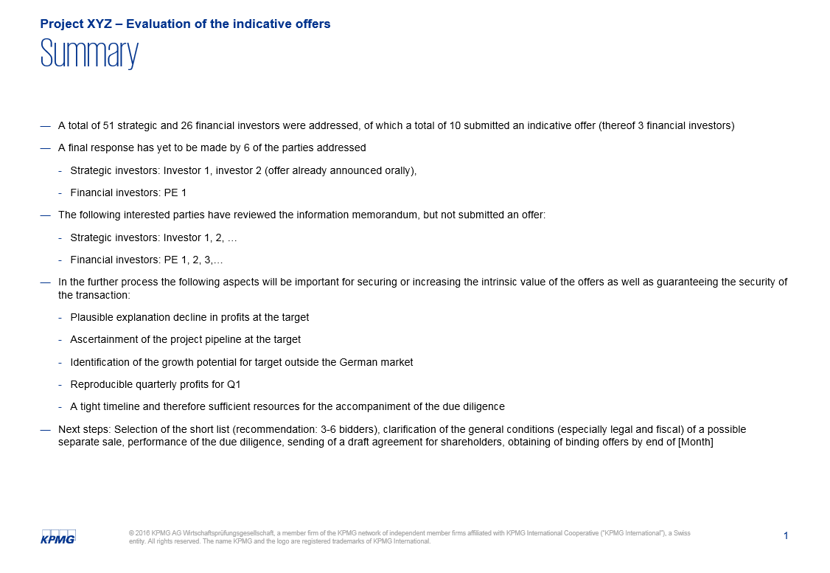
Content of an offer analysis presentation: Executive summary
Process Letter and Analysis of Offers
The Analysis of Offers is a document that is directed at the owners of the business that is about to be sold. It provides them with a first indication of the interest for and the price level of their business.
Usually, the potential bidders have been provided with the Information Memorandum (combined with the Process Letter) as a basis for their indicative bid.
1
1
2
2
PPT FILE: Template for an Analysis of Offers
EXCEL FILE:
Template for an Analysis of Offers
Tools
For editable template refer to the attached Power Point and Excel tools

Slide 16
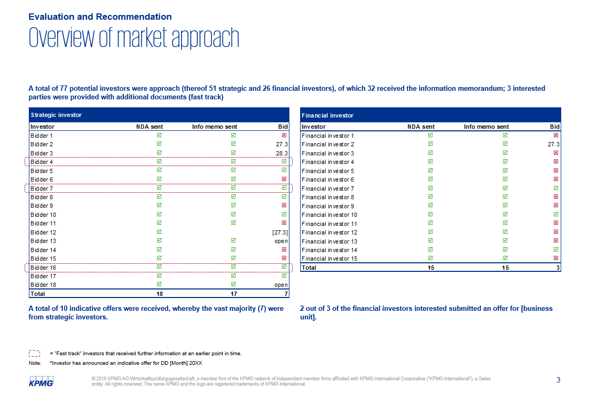
Content of an offer analysis presentation: Overview
Process Letter and Analysis of Offers
The overview of the market approach is usually divided between strategic and financial investors since these two buyer groups differ significantly: Typically, financial investors are much faster and more flexible than strategic players but on the other hand tend to pay lower prices (e.g. due to a lack of synergy potential).
The example on the right hand side shows that there are several buyers that are considered particularly relevant regarding transaction security and strategic fit and hence are given preferred treatment: This is only allowed if the transaction is not a public tendering process, otherwise the discrimination of any potential buyers would be illegal.
3
3
4
Tools
For editable template refer to the attached Power Point and Excel tools on page 15
4

Slide 17
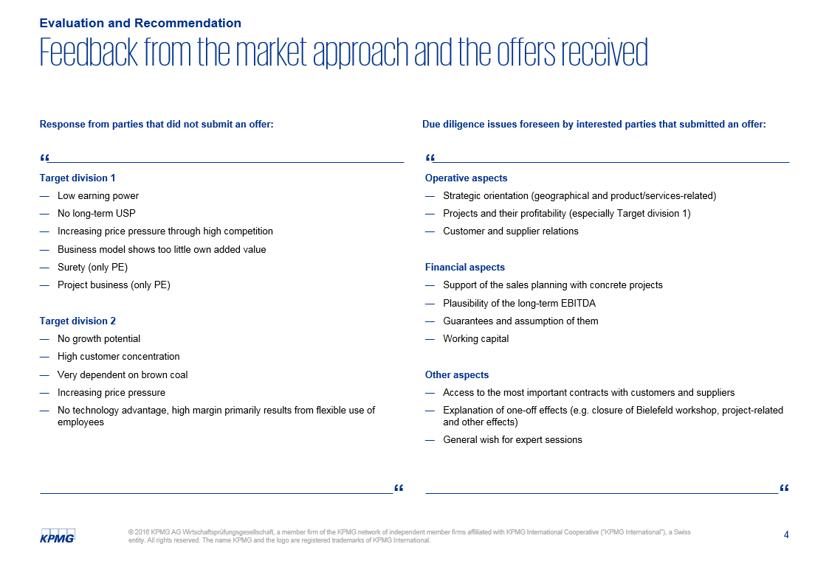
Content of an offer analysis presentation: Qualitative feedback
Process Letter and Analysis of Offers
In case a potential bidder refrains from the target, the client will seek to understand why anyone “scorns” his company (in particular if it is a family owned business). Therefore, it is important to select the most relevant and frequently mentioned reasons for denial and include them in the Analysis of Offers.
In order to give the client a better feeling of where the focus of the further due diligence will be and to give the management an idea of what they can expect during the expert sessions it makes sense to include a section about this in the Analysis of Offers.
5
5
6
6
Tools
For editable template refer to the attached Power Point and Excel tools on page 15

Slide 18
Content of an offer analysis presentation: The initial price tag
Process Letter and Analysis of Offers
In the case presented on the right hand side, the target company consists of several divisions. Hence potential buyers bid on (a) the Target group, (b) Target division 1 only and (c) Target division 2 only.
A visualization of the bid is extremely helpful, but only if the prices are comparable. For example, if Co. 5 (the highest bidder for the Target Group) aims to pay the price over 5 years and Co. 4 (the second highest bidder) offers to pay the amount in a lump sum in cash one day after signing, the choice might not be as clear as the picture suggests.
Oftentimes, M&A advisors think in terms of EBITDA or EBIT multiples for the sake of comparability with e.g. previous transactions.
7
7
8
8
9
9
Tools
For editable template refer to the attached Power Point and Excel tools on page 15

Slide 19
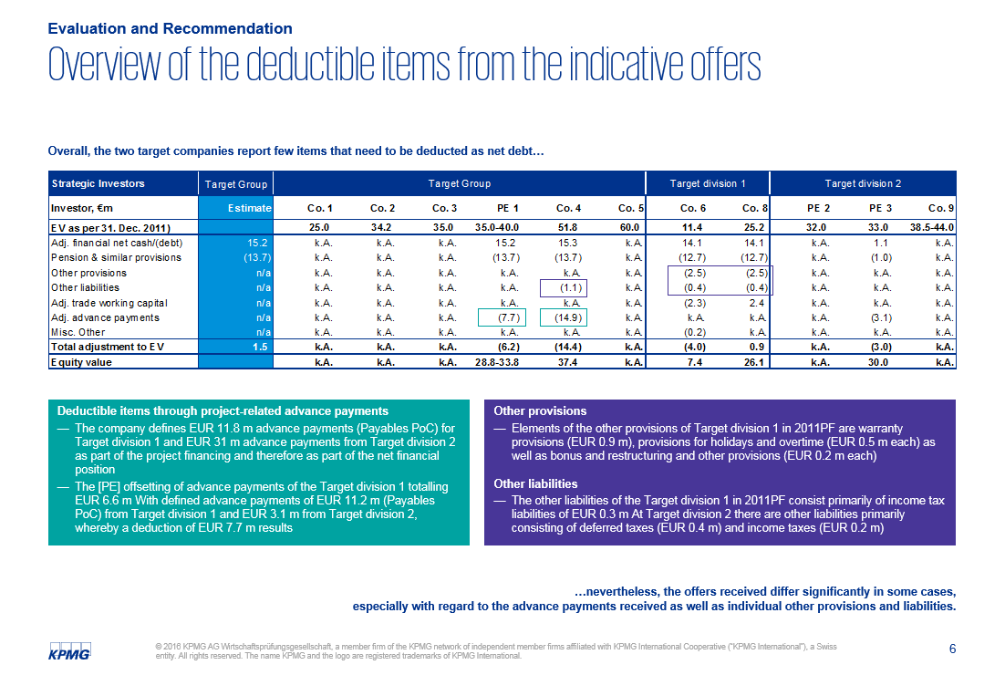
Content of an offer analysis presentation: The actual price tag
Process Letter and Analysis of Offers
In most transactions, the Process Letter asks for a value “on a cash and debt free basis^{(a)(b)}” mainly in order to (1) make the different offers comparable and (2) to reflect the view of the purchaser who needs to come up with both the amounts for the debt and equity capital.
As different buyers consider different balance sheet items as net debt^{(b)} and KPMGs client in most cases will receive the equity value as compensation for his share, it is necessary to break the enterprise value down line by line until only equity value remains.
Now the value of a well structured and thought through Process Letter is revealed.
10
10
11
11
Tools
For editable template refer to the attached Power Point and Excel tools on page 15
Note: (a) Cash and debt free basis: The value of the business if it did not have any net debt
(b) Net debt: Net value of a company's interest bearing liabilities/debts (against which third parties hold a contractual claim) and its cash/liquid assets

Slide 20
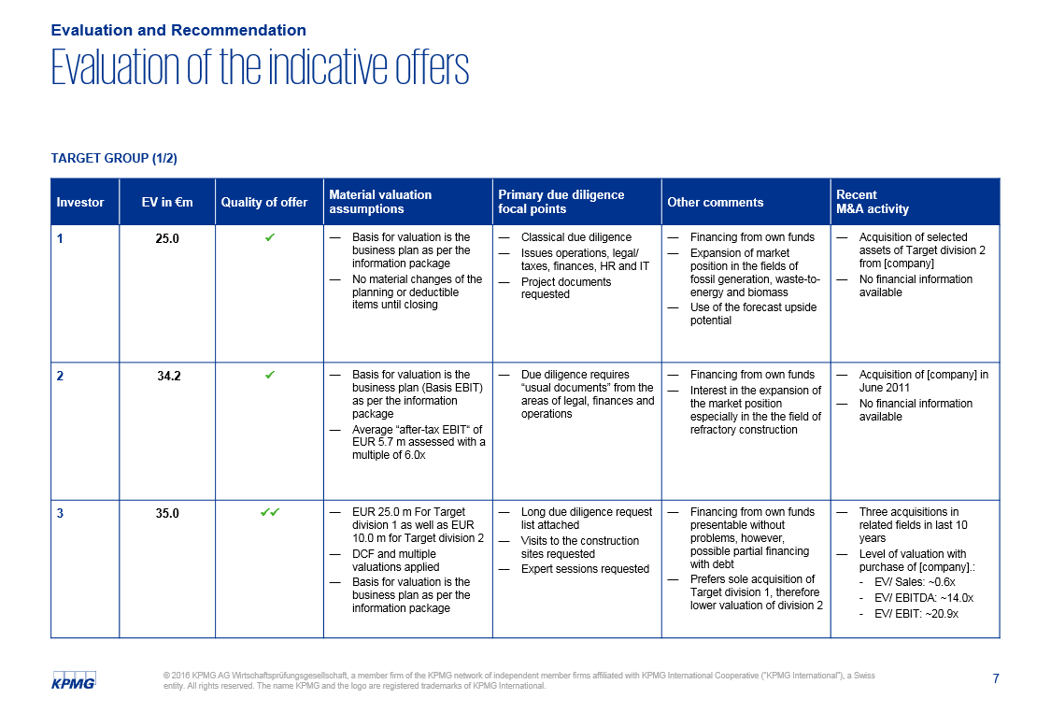
Content of an offer analysis presentation: Detailed evaluation
Process Letter and Analysis of Offers
To give the client a clearer picture of the individual offers without providing too much detail, the information needs to be summarized:
Serves as a proxy for the seriousness of the bidder: The higher the quality, the less is the likelihood that he participates in the process in order to gain competitor insights
Provides background of the valuation methodology
Gives guidance regarding the key due diligence areas
Any other qualitative points that are considered material
Serves as another proxy for the transaction security and seriousness of the bidder
12
12
13
14
15
16
13
14
15
16
Tools
For editable template refer to the attached Power Point and Excel tools on page 15
Note: Only page 1 of the detailed evaluation is presented in the above slide.

Slide 21
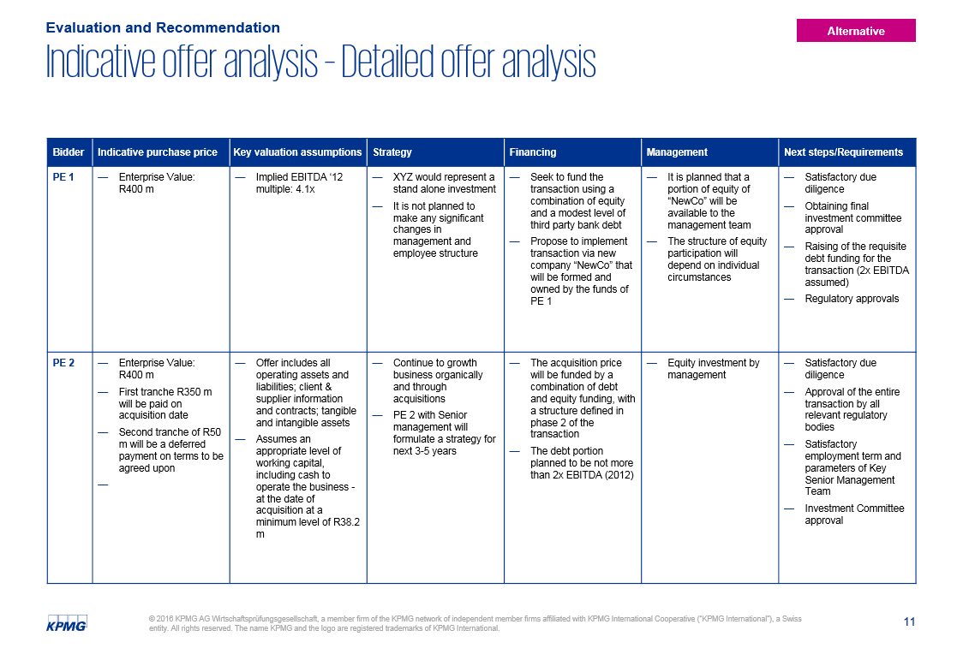
Content of an offer analysis presentation: Detailed evaluation (alternative)
Process Letter and Analysis of Offers
Of course, there is more than one way of breaking down each bid. The level of detail depends on:
The degree of customer engagement in the process (“hands-off” versus “hands-on”)
The level of detail requested in the Process Letter
The phase of the process (initial bids versus final offers)
The focus set by the customer (e.g. maximize purchase price vs. transaction security)
Etc.
Tools
For editable template refer to the attached Power Point and Excel tools on page 15
Note: The above table refers to another example which has not been touched upon in this workbook.

Slide 22
© 2017 KPMG International Cooperative (“KPMG International”). KPMG International provides no client services and is a Swiss entity with which the independent member firms of the KPMG network are affiliated.

